Slide 1

Password Manager 🔐
By
NIDHI BHANUSHALI ( 1911004 )
KASHISH HARISINGHANI ( 1911016 )
SYBtech Comps A1

Slide 2
Introduction
Today we have various Apps/Sites where we register & use. Some use same
Passwords
Email Address
Usernames for all or different for each.
Some have more than 1 Account for an App/Site.

Slide 3
The Problem with
the
Solution
Remembering all of these details can be Tedious and we may tend to forget them.
Thus, Password Manager can be useful to remember & manage Account Related Details.

Slide 4
Problem Definition
Passwords management is an important aspect of computer security, it’s the front line of protection for user terminals and it is by far the most common user authentication method within the largest multinational organizations. Managing and maintaining passwords is crucial since now-a-days we need to change passwords for different applications frequently to minimize security risks to the application. Our project implements a simple password manager system where the user can create his account and store passwords for various applications along with the username and email used for creating account on that application.

Slide 5
SCOPE OF THE
PROJECT
Scope of the project is implemented as follows
User Registration & Login functionality using GUI
Adding new passwords for each user
Updating Existing Details in the database.
Deleting existing passwords from the database

Slide 6
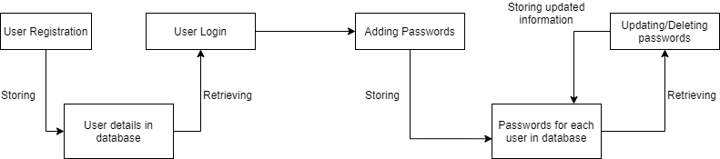
FLOW DIAGRAM (COMPONENT DIAGRAM)

Slide 7
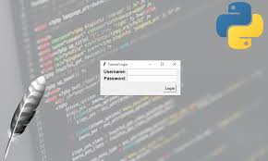


PACKAGES & APIs
Packages and modules used in the project
Python tkinter: for creating User-Interface of the application
Python sqlite3: for Database

Slide 8
Difficulty Faced & how We overcame it
The major difficulty faced by us was to create a table and enable selecting of rows inside it to allow users to edit the values that they have previously set. In order to achieve this, we used a TreeView which is available in tkinter.

Slide 9
Team Work
Nidhi - Front & Back End (Main Page, Create new, Update)
Kashish - Front & Back End (Login, Register, Delete)

Slide 10
CONCLUSION
The project helps us understand python tkinter module thoroughly and various queries of database. The project clears the concept of how CRUD operations can be done using python and sqlite3
Apart from that we also have a working password manager system to store passwords for different applications and retrieve it when necessary.

Slide 11
Thank You !
☺

